Slide 1
Buddhism
Buddhism began in northeastern India and is based on the teachings of Siddhartha Gautama. The religion is 2,500 years old and is followed by 350 million Buddhists worldwide.
Buddhism is the main religion in many Asian countries. It is a religion about suffering and the need to get rid of it. A key concept of Buddhism is Nirvana, the most enlightened, and blissful state that one can achieve. A state without suffering.

Slide 2
Basic Facts about Buddhism
Place of Origin North East India
Founder: Siddhartha Gautama(The Buddha)
Sacred Text: Tripitaka
Sacred Building: Stupa
Major Festivals: Wesak
Main Branches (Denominations) Theravada, Mahayana, Tibetan, Chinese and Japanese groups including Soto and Zen

Slide 3
How is Buddhism different from other religions?
Buddhism is different from many other faiths because it is not centered on the relationship between humanity and God. Buddhists do not believe in a personal creator god.

Slide 4
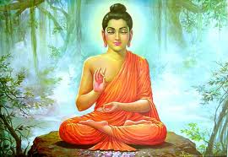
Who is the founder of Buddhism?
The Buddhist tradition is founded on and inspired by the teachings of Siddhartha Gautama. He was called the Buddha and lived in the 4th or 5th century B.C. in India.

Slide 5
Why is Siddhartha Gautama so important to Buddhists?
Siddhartha Gautama found the path to Enlightenment. By doing so he was led from the pain of suffering and rebirth towards the path of Enlightenment and became known as the Buddha or “enlightened one".

Slide 6
Who was Siddhartha Gautama?
Siddharta Gautama is known as the Buddha.
He was born around the year 580 BCE in the village of Lumbini in Nepal. He was born into a royal family and for many years lived within the palace walls away from the sufferings of life; sufferings such as sickness, age, and death. He did not know what they were.
One day, after growing-up, marrying and having a child, Siddhartha went outside the royal palace and saw for the first time an old man, a sick man, and a corpse. He was worried by what he saw. He learned that sickness, age, and death were the inevitable fate of human beings — a fate no-one could avoid.

Slide 7
Why did Siddhartha Gautama stop being a prince and become a Holy Man?
Siddharta had also seen a monk, and he decided this was a sign that he should leave his protected royal life and live as a homeless Holy Man.
Siddharta's travels showed him much more of the the suffering of the world.
He searched for a way to escape the inevitability of death, old age and pain first by studying with religious men. This didn't provide him with an answer.

Slide 8
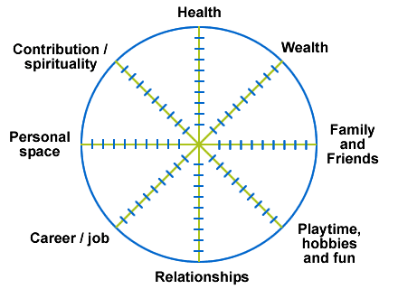
What are the symbols of Buddhism?
The wheel of life which symbolizes the cycle of life, death and rebirth. The eight spokes remind people that the Buddha taught about eight ways of life.

Slide 9
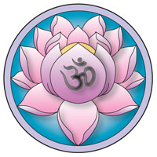
What are the symbols of Buddhism? Continued…
The lotus flower symbolizes purity and divine birth. The lotus flower grows in mud at the bottom of a pool, but rises above the surface to become a beautiful flower. Buddhist say this is how people should rise above everything which is dukkha. A flower may be very beautiful and have a wonderful scent, but it soon withers and dies. This shows that nothing in life is perfect.

Slide 10
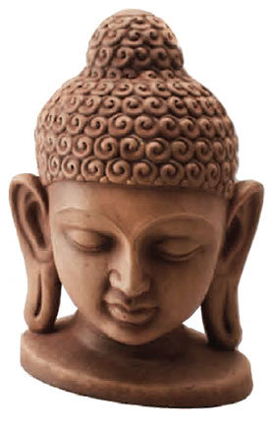
What are the symbols of Buddhism? Continued…
Images of Buddha
Statues of Buddha include lots of symbols. There are 32 symbols in Buddhism
which show that the Buddha was a special person. Any of these symbols can
be used on statues. For example the Buddha is often shown with:
a bump on the top of his head - a symbol that he had special talents.
a round mark on his forehead, which is his third eye - a symbol to show that he could see things ordinary people cannot see.
curled hair (the curls are actually snails that kindly covered his head-shaved because he renounced the worldly life- to protect him from the sun as he sat meditating.) They are a symbol that he was a very holy man.
long ears from the weight of his princely earrings-now missing because he renounced his worldly life. (Sidhartha didn't just give up being rich, but also, renounced being head of an army as a prince, which shows his non-violence.)

Slide 11
Where do Buddhists Worship?
Buddhist worship at home or at a temple. Worshippers may sit on the
floor barefoot facing an image of Buddha and chanting. It is very
important that their feet face away from the image of Buddha. They
listen to monks chanting from religious texts and take part in prayers.
Home
Buddhists will often have a shrine. There will be a statue of Buddha, candles, and an incense burner.
Temple
Buddhist temples come in many shapes. Perhaps the best known are the pagodas of China and Japan. Another typical Buddhist building is the Stupa (upside down bowl shape). All Buddhist temples contain an image or a statue of Buddha.

Slide 12
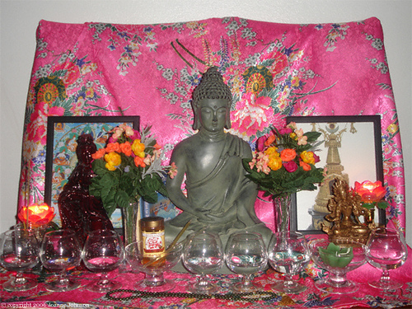
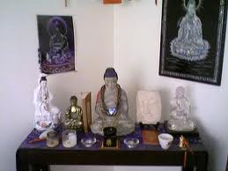
Buddhist Shrines at Home

Slide 13
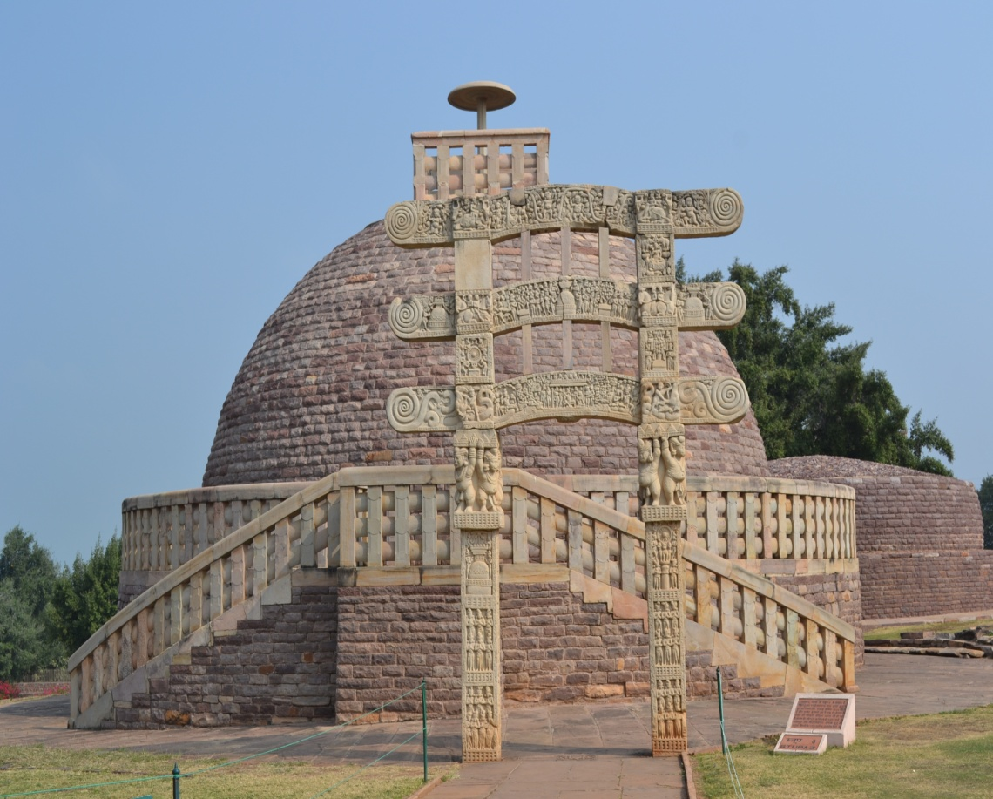
Buddhist Pagoda and Stupa

Slide 14
How do Buddhists Worship?
Buddhist worship is called puja. People chant to show their love for the Buddha. They make offerings of flowers, candles, incense and pure water at a shrine. People thank Buddha for his teachings.
When Buddhist worship alone they usually meditate and read from the Buddhist holy books.
Every month. most Buddhists have special religious days. These are often days when there is a full moon. Many Buddhists go to temples to worship on these special days.

Slide 15
What is Enlightenment and Nirvana / Nibbana?
Buddhist believe that there is a cycle of birth, life, death and rebirth. This goes on and on. They believe that unless someone gains Enlightenment, when they die they will be reborn. If a person can gain Enlightenment, they can break out of this cycle.
Breaking out of the cycle is called Nirvana (sometimes called Nibbana). It is the end of everything that is not perfect. It is perfect peace, free of suffering.

Slide 16
Meditation
Buddhists try to reach Nirvana by following the Buddha's teaching and by meditating. Meditation means training the mind to empty it all of thoughts. When this happens what is important comes clear.

Slide 17
What is the sacred text (Holy Book) of Buddhists?
The sacred book of Buddhism is called the Tripitaka (called Tipitaka in Pali). It is also called the Pali Canon, after the language in which it was first written.
It is written in an ancient Indian language called Pali which is very close to the language that the Buddha himself spoke. The Tripitaka is a very large book. The English translation of it takes up nearly forty volumes.
Buddhism is based on Buddha's teachings. At first these were passed down by word of mouth and later were complied into two sets of scripture. One set by Council of Monks of the Theravada school (the Tripitaka) the other by the Mahayana school ( the Sutras). Both were similar.
Both Theravada and Mahayana Buddhists generally accept the Tripitaka (called Tipitaka in Pali) as the Buddhist sacred writings.
The three section of the Tripitaka (three baskets of Wisdom) are
Vinaya Pitaka (the Discipline Basket) - A rule book for monks and nuns There are 227 rules for monks,and more for nuns.
Sutta Pitaka (the Teaching Basket)- The actual experiences of Buddha
Abhidhamma Pitaka (the Higher Doctrine Basket)- An explanation on the teaching of Buddha. Most of these are called Sutras
Parts of the Tripitaka such as the Dhamma-pada and the Sutta-Nipata are among the most expressive religious books in the world. Some of Buddha's parables are very similar to those used by Jesus.

Slide 18
What do Buddhist believe?
Buddhist believe that the Buddha saw the truth about what the world is like. They believe that nothing in the world is perfect, and that the Buddha found the answer to why it is like this. They do not believe that the Buddha was a god. He was a human being just like them. They believe that he was important because he gained Enlightenment, and he chose to teach other people how to reach it too.

Slide 19
The Three Jewels
There are three Buddhist central beliefs. These are known as the three jewels as they are felt to be so precious.
Belief in Buddha
Dharma - The teaching of Buddha
The Sangha - the Buddhist community made up of ordinary people as well as the monks and nuns. The purpose is to help others and by doing so to cease to become selfish and to move on the way towards enlightenment.
One important belief involves reincarnation: the concept that one must go through many cycles of birth, living, and death. After many such cycles, if a person releases their attachment to desire and the self, they can attain Nirvana - a state of liberation and freedom from suffering.
At the heart of the Buddha's teaching lie The Four Noble Truths and The Eightfold Path which lead the Buddhist towards the path of Enlightenment.

Slide 20
What did Buddha teach?
The Buddha's teaching is often divided into three parts. These are the :
Three Signs of Beings
Four Noble Truths
Noble Eightfold Path

Slide 21
The Three Signs of Being
The Three Signs of Being are the ways that the Buddha used to describe life. Nothing in life is perfect. ( dukkha) It includes things like being bored and uncomfortable, and everything which is not satisfactory.
Everything in life - even solid things such as mountains - is changing, all the time. (anicca)
There is no soul. (anatta) Instead, the Buddha taught, what does carry on to the next life is a person's life force (Karma). The Karma can be good or bad, depending on how the person lives in this life.

Slide 22
The Four Noble Truths
What is the First Noble Truth?
Dukkha: Suffering exists: The first truth is that life is suffering i.e. life includes pain, getting old, disease, and ultimately death. We also endure psychological suffering like loneliness frustration, boredom, fear, embarrassment, disappointment and anger.
What is the Second Noble Truth?
Samudaya: There is a cause for suffering. The second truth is that suffering is caused by craving and the needing to control things. It can take many forms: the desire for fame; the desire to avoid unpleasant sensations, like fear, anger or jealousy.
What is the Third Noble Truth?
Nirodha: There is an end to suffering. The third truth is that suffering can be overcome and happiness can be attained; that true happiness and contentment are possible. lf let go of our craving and learn to live each day at a time (not dwelling in the past or the imagined future) then we can become happy and free. We then have more time and energy to help others. This is Nirvana.
What is the Fourth Noble Truth? Magga: In order to end suffering, you must follow the Eightfold Path. The fourth truth is that the Noble 8-fold Path is the path which leads to the end of suffering.
What is Dukkha?
Dukkha is suffering.
All existence is "dukkha"; without permanence and therefore filled with suffering.

Slide 23
The Noble Eight-Fold Path
The Noble Eight-fold Path focuses the mind on being fully aware of our thoughts and actions, and developing wisdom by understanding the Four Noble Truths. It is the way Buddhists should live their lives. The Buddha said that people should avoid extremes. They should not have or do too much, but neither should they have or do too little. The 'Middle Way' is the best.
The path to Enlightenment (nirvana) is through the practice and development of wisdom, morality and meditation.
Three Qualities Eightfold Path
Wisdom (panna) Right View (understanding)
Right Thought
Morality (sila) Right Speech
Right Action
Right Livelihood
Meditation (samadhi) Right Effort
Right Mindfulness
Right Contemplation (concentration)

Slide 24
What are the 5 Precepts (morals)?
These are rules to live by. The main five are:
Do not take the life of anything living. (Do not kill)
Do not take anything not freely given. (Do not steal)
Abstain from sexual misconduct and sensual overindulgence.
Refrain from untrue speech, (Do not lie)
Do not consume alcohol or other drugs. The main concern here is that intoxicants cloud the mind.

Slide 25
What is Karma?
Karma is the law that every cause has an effect, i.e., our actions have results. This simple law explains a number of things: inequality in the world, why some are born handicapped and some gifted, why some live only a short life. Buddhists believe that our past actions have an effect on who or what we are in our next life.

Slide 26
Are There Different Types of Buddhism?
There are many different types of Buddhism, because the emphasis changes from country to country due to customs and culture. What does not vary is the essence of the teaching — the Dhamma or truth.
Theravada Buddhism, the school of Buddhism found in Burma, Thailand, Sri Lanka, Laos, Cambodia, Myanmar & in part, Indonesia, Vietnam & Malaysia. Mahayana Buddhism, the school of Buddhism found in China, Japan, Korea and Vietnam. Vajrayana Buddhism, the school of Buddhism found in Tibet, Nepal, Sikkim, Bhutan and Mongolia. Jodo Shin Buddhism or Pure Land Buddhism mainly from India, Japan

