Slide 1
Welcome!
6th Grade English
Tuesday, September 2nd, 2014

Slide 2
About Me
Mr. Chesser
6th Grade English Language Arts
Tuesday, September 2nd, 2014

Slide 3
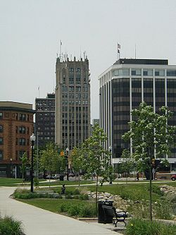
Where I’ve Been: I am from Jackson, Michigan

Slide 4
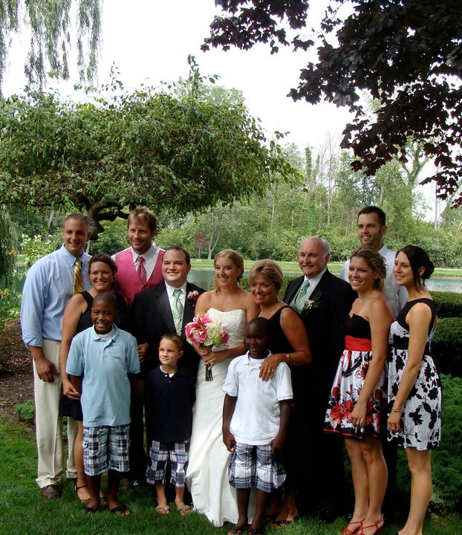
Family

Slide 5
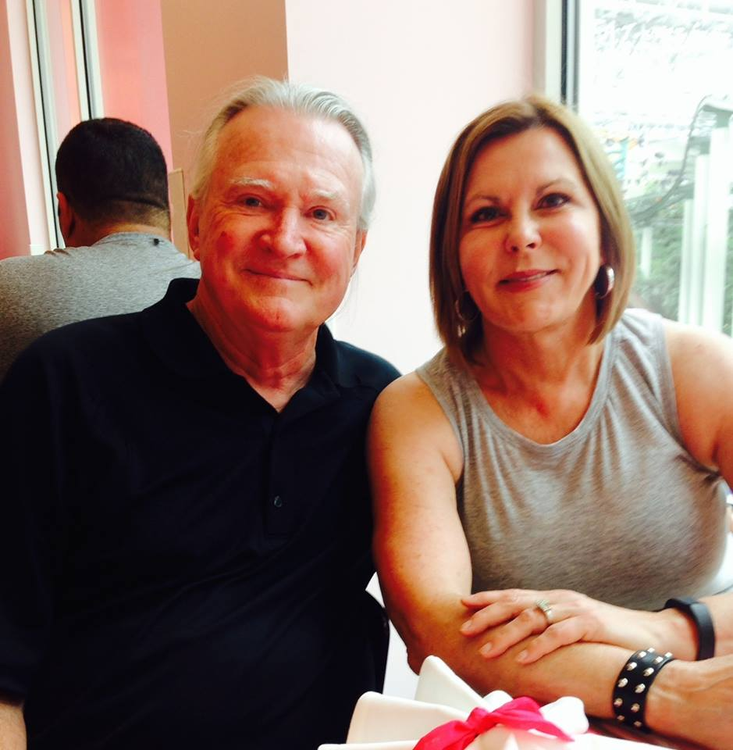
Family

Slide 6
Jackson, Michigan
Graduated from Jackson Christian High School in 2001
Attended Jackson Community College for 2 years until I left Jackson in the summer of 2003

Slide 7
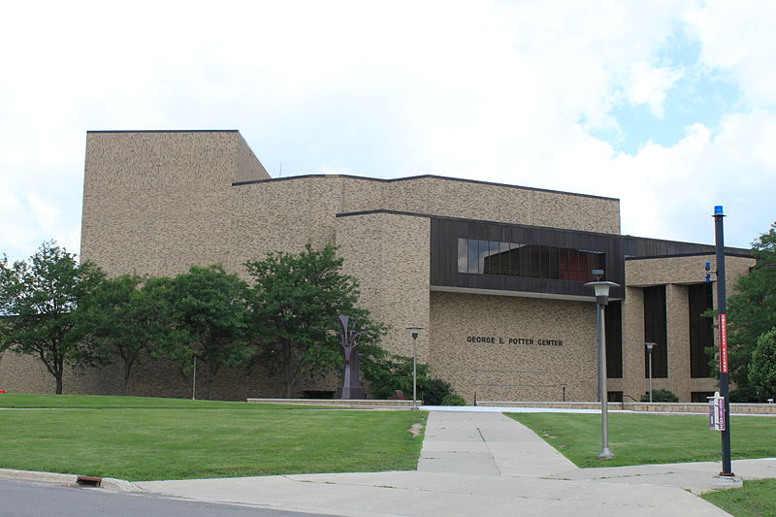

Slide 8
After Jackson….
I moved to Kalamazoo, Michigan
Attended Western Michigan University until graduation in April 2007
Met my wife Melissa at WMU
Studied History and English within the Department of Education

Slide 9
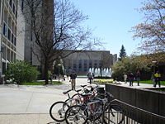

Slide 10
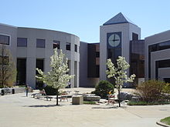

Slide 11
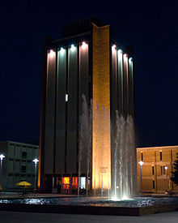

Slide 12
South Carolina
After graduation, I moved with Melissa to Florence, South Carolina where I taught 4 years
2 years as an English teacher, 2 years as a Social Studies teacher
Taught at J. Paul Truluck Middle School

Slide 13
Back to Michigan…
Melissa and I moved back to Michigan in the summer of 2011 where I began teaching at KMS
This is my 4th year at Kennedy – my first year I taught Social Studies, this is my 3rd year teaching 6th Grade ELA
We have 2 cats (Buddy and Kiki) and 2 dogs (Charlie and Colton)

Slide 14
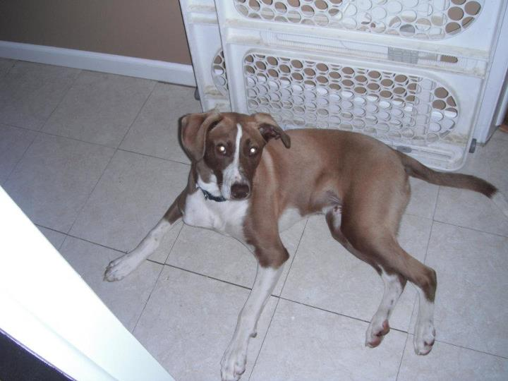
Charlie

Slide 15
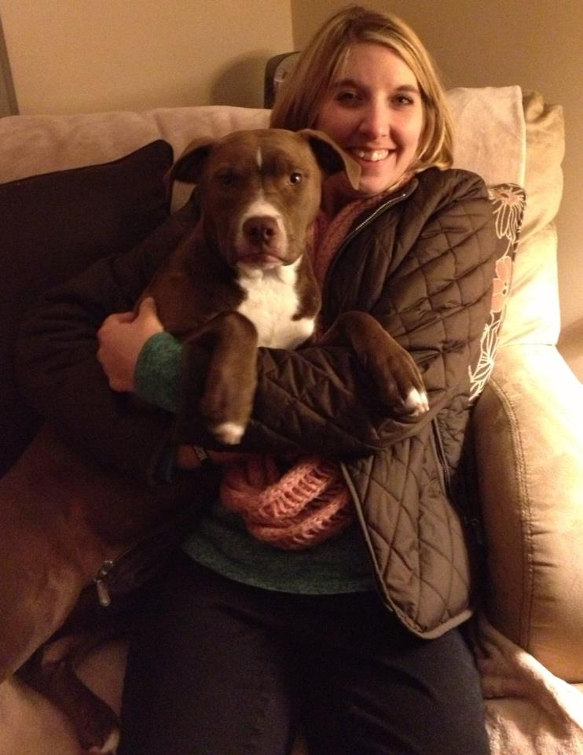
Colton

Slide 16
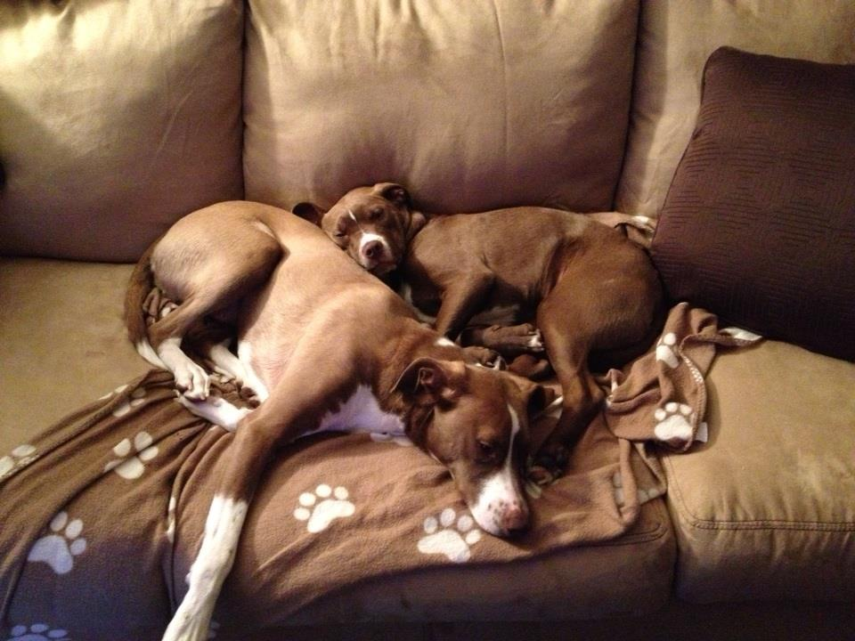

Slide 17
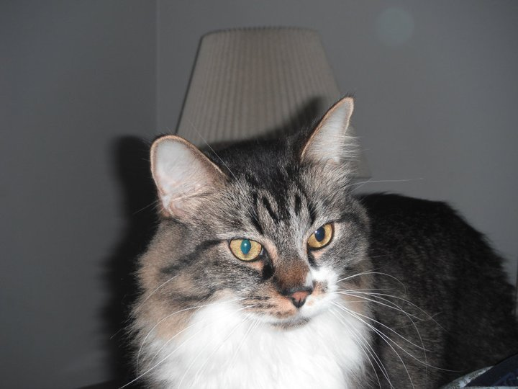
Buddy

Slide 18
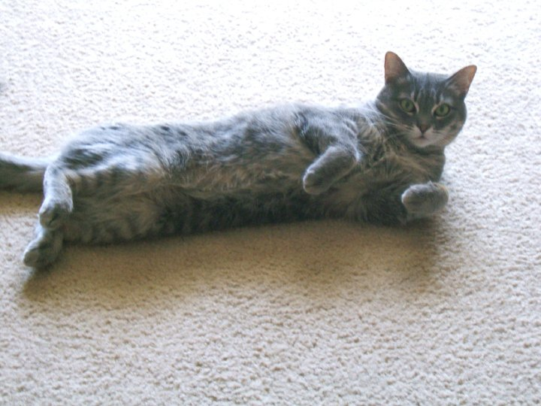
Kiki

Slide 19
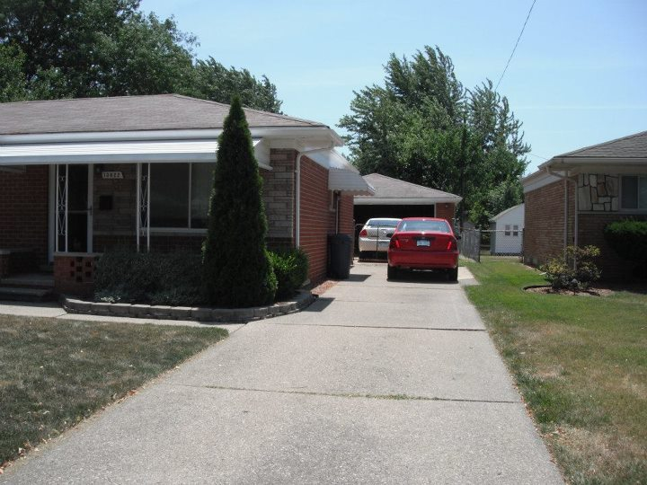

Slide 20
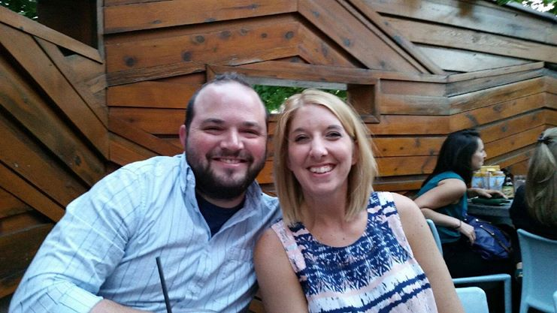

Slide 21
Interests and Hobbies/Final Comments
Let me get this out there right away – I’m a huge geek about almost everything
Comics
Movies
Video games
Also, I obviously love reading

